Slide 1
Wine Sale Price Predictor
Jonathan Hughes

Slide 2
Stakeholder
The stakeholder is a new winery in the area and has hired me to help predict the price of his wines. The stakeholder wants to be competitive with the other wineries in the area and not overcharge or undercharge for their wine.

Slide 3
The data
The data used is Spanish Wine data which includes many features such as region, wine, winery, year, boldness, acidity, rating and sales price.
Price is not U.S. dollars but rather Spain’s currency Euros.
There are over 7500 different wines in the data

Slide 4
What determines sale price?
When looking at all the data there are multiple factors into the sales price of wine.
Acidity
Boldness
Type
Rating

Slide 5
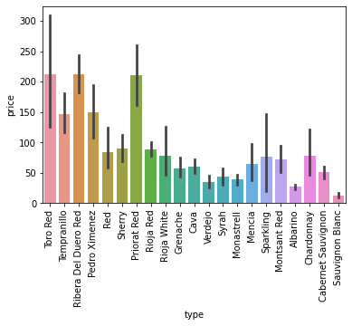
Type and Price
This graph shows the types of wine related to the price.
Here we find that the red wines have a higher sale price.

Slide 6
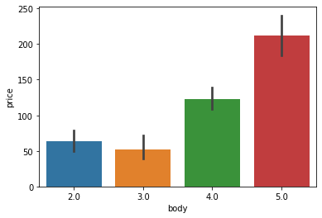
Body and Price
This graph shows the relationship between the body of the wine and the price of the wine.
Here we see the higher the body of the wine the higher the price of the wine.

Slide 7
Model
Prediction: Price of the wine
Multiple Models Used: KNN, Linear Regression. PCA KNN, PCA Linear Regression
PCA KNN Model: Performed the best prediction sale price with MAE of 57 Euros.
PCA KNN is the model I chose

Slide 8
Recommendation
To optimize the price of the wine I recommend focusing on the body, acidity and type to get a good wine rating. From the information gathered I recommend to make a red wine that has a high body to be able to get a high priced wine to sell.

